Slide 1
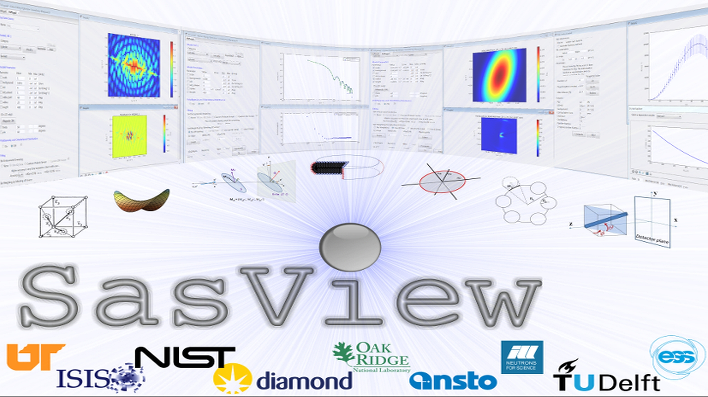
Overview: Current structure, functionality, and Community Development Model

Slide 2
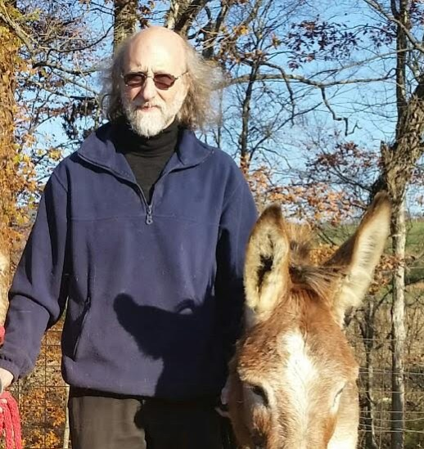
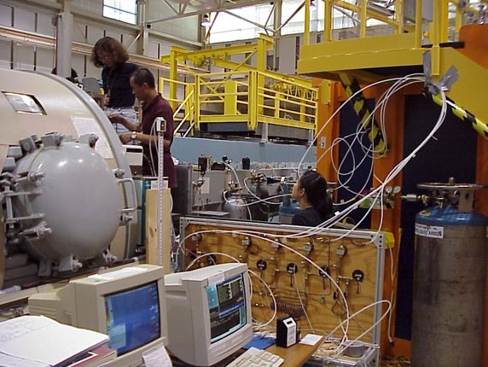
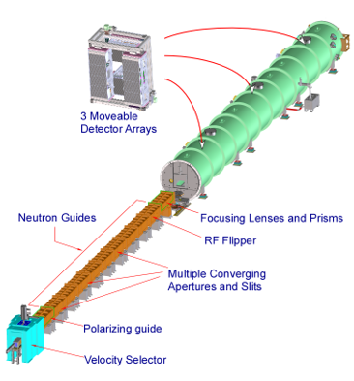
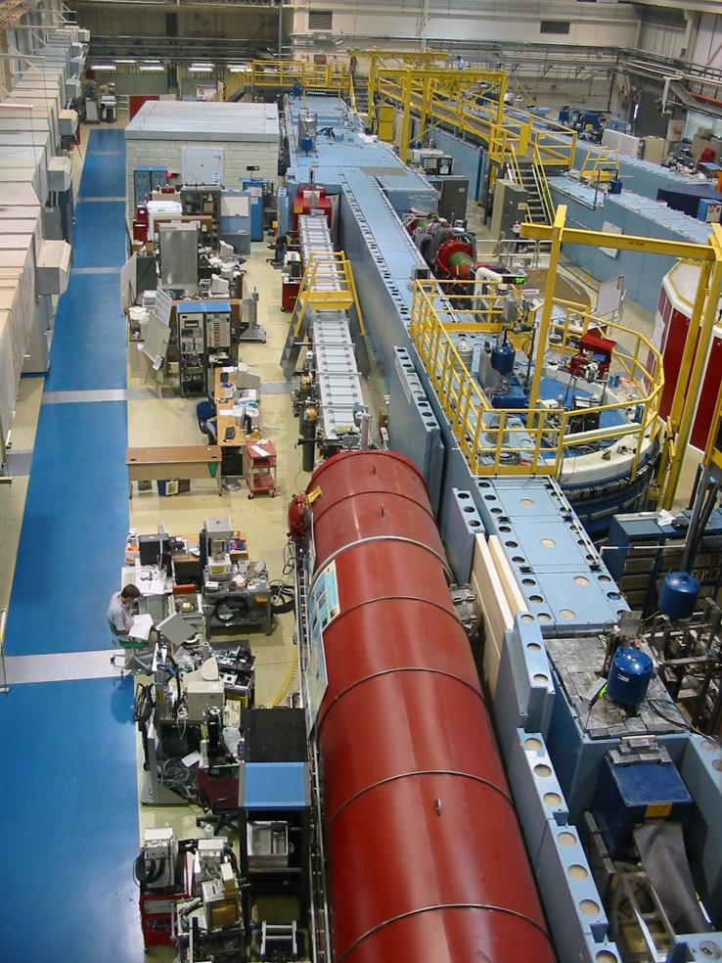
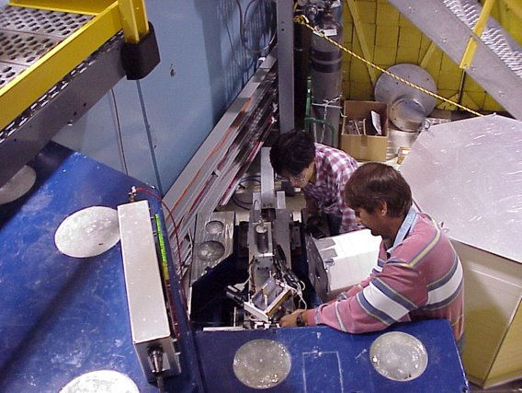
Notes from the Speaker (my 5 min)
Scattering since last millennium
Leader of the NIST small angle group since 2004

Slide 3
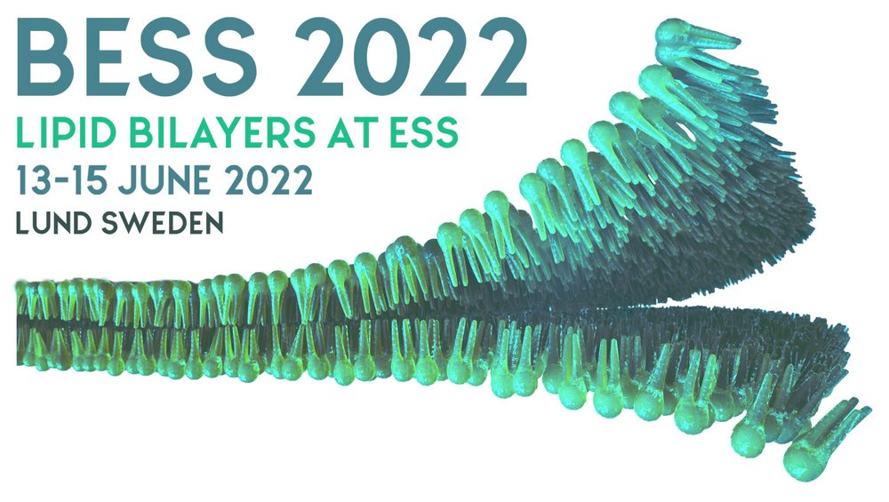
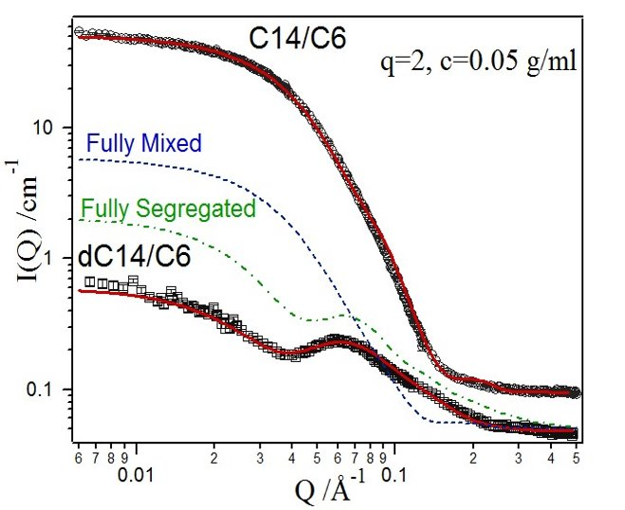
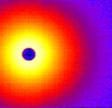

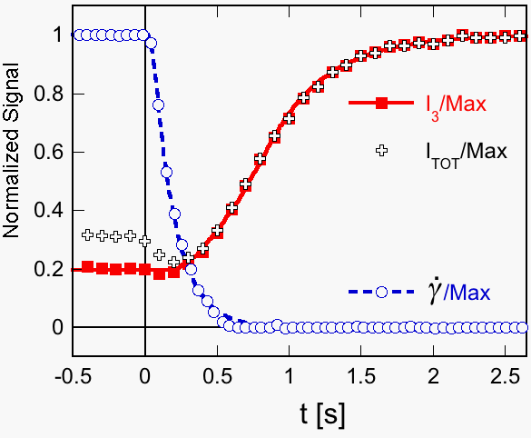
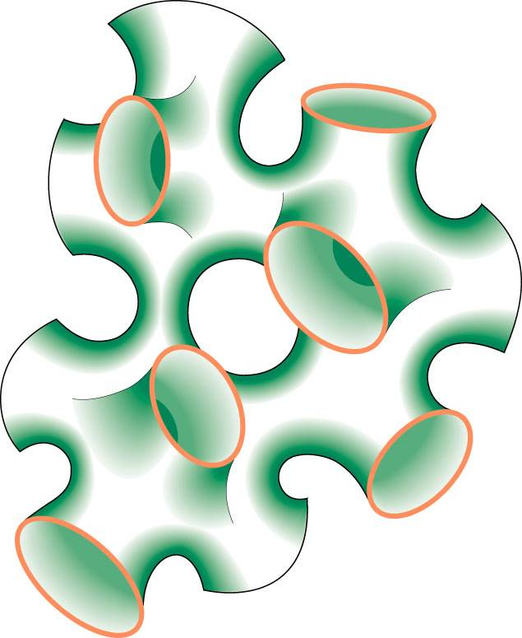
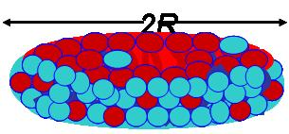

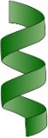
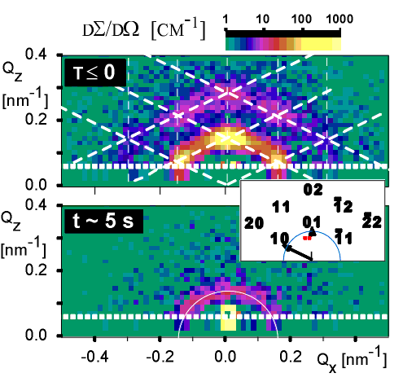
Notes from the Speaker (my 5 min)
Colloid/self-assembly scientist
Ordering of wormlike micelles near a surface and under flow
Flow induced sponge to lamellar transition and relaxation
Energetics of fusion
Lipid membrane structure and dynamics
Segregation of lipids in mixed lipid system

Slide 4
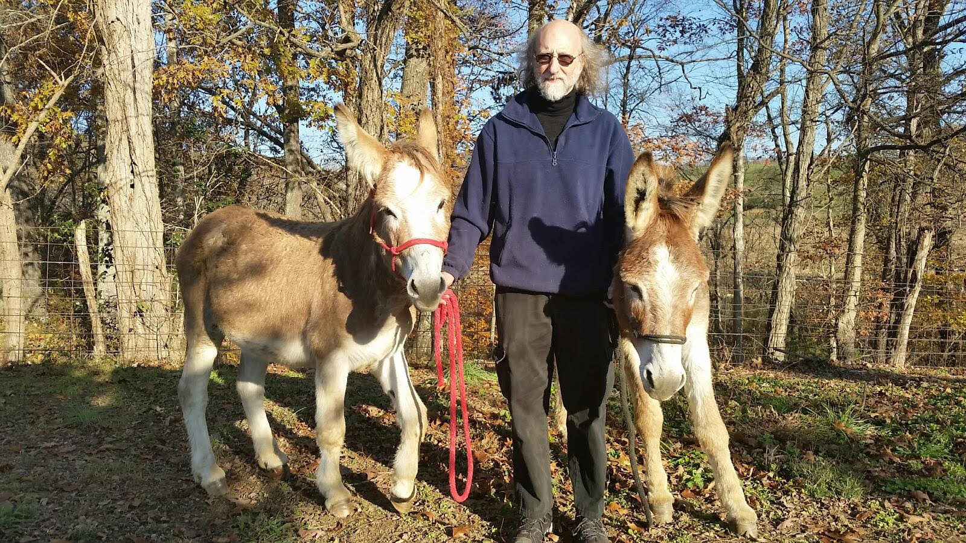

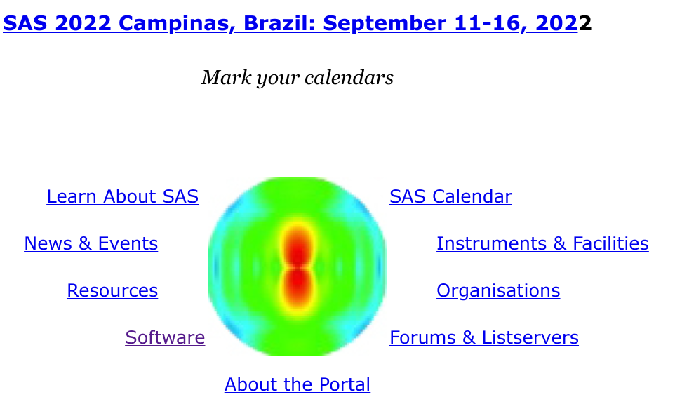
Notes from the Speaker (my 5 min)
Long standing interest in building SAS and scattering community and collaboration
SasView
canSAS​
CCP-SAS
canSAS V (2007)
Reduced formats (NXcanSAS)
Inter-facility standards
SAS portal (smallangles.org)
IGOR collaborations
Facility rep quarterly meetings

Slide 5
SasView: A SAS data analysis platform
Data Analysis eh?
…. So what exactly does that mean?
Only works on Reduced data
(All the instrumental artifacts are removed and only the science is left)
…. Sorta

Slide 6
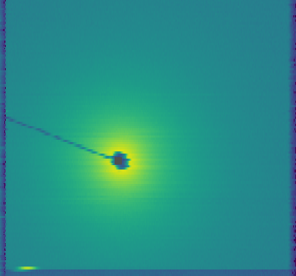
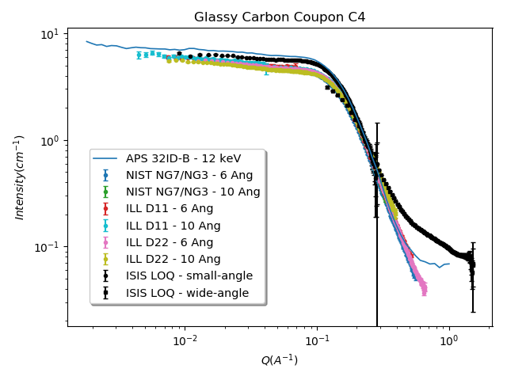
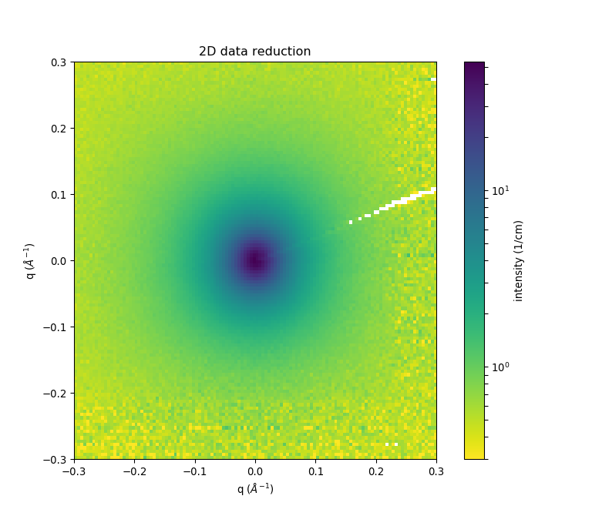
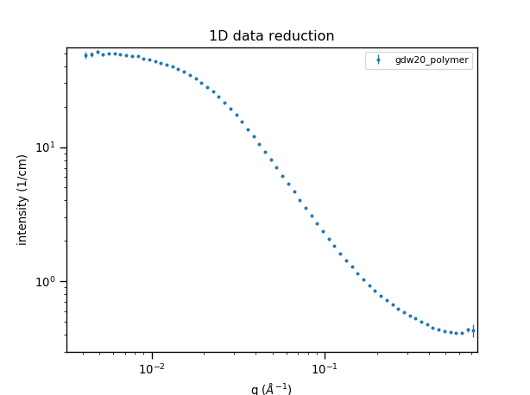
Experimental Data Flow
Reduced data should be reproducible anywhere!
Data Acquisition System
Instrument-
dependent
data
‘raw’ data file
(NXS)
Data Reduction Programs
(e.g. Mantid)
Instrument-
independent
data
reduced data file
(1D: HDF / XML / TXT; 2D: HDF / TXT)
http://www.cansas.org
Data Analysis Programs
Paper / Thesis
Notes:
Penultimate step in a ‘data processing pipeline’

Slide 7
Analysis Software – Who's job is it anyway

Slide 8
The resource Problem Part I
Analysis Software - Who’s Job is it Anyway?
Scattering is an analysis tool and part of providing the tool should be the necessary software
→ the FACILITY’S JOB
$$MONEY$$
Source Construction
Analysis is where the science is
→ the USER’S JOB
Civil Construction
Reduction Sofware
Data Hardware
Analysis
Software??
Instruments
Or maybe …..
→ The Domain Science funding agencies?
Time

Slide 9
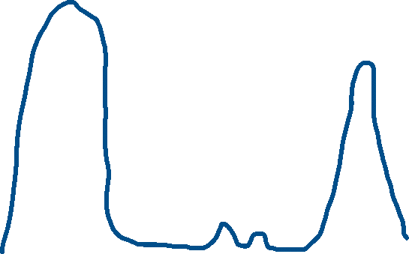
The resource Problem Part II
The feast and famine roller coaster
Analysis Software - Who’s Job is it Anyway?
- The domain science funding agencies
The Valley(s) of death
Facility directors discretion, NIH, NSF, DOE, etc.
Special funding (grants) do no fund long term maintenance and ongoing development. They fund “big new (transformative) ideas”
$$MONEY$$
Time

Slide 10
The resource Problem Part III
The unbounded problem
Fundamentally all these elements are relatively well defined problems…
EXCEPT ...
Analysis Software is really unbounded. The needs are nearly infinite and constantly evolving.
$$MONEY$$
Source Construction
Reduction Sofware
Civil Construction
HOWEVER --- Analysis as defined here is also uniquely universal and ripe for collaborative pooling of finite resources
…. But beware the monoculture?
Data Hardware
Analysis
Software??
Instruments
Time

Slide 11
The resource Problem Reframed – The Need
A way to focus limited resources on top priorities (most useful to the science being done) in a world of infinite possibilities
A way to harness funding for bold new ideas without losing the investment in the valleys of death
A way to provide sustained maintenance and development in an uncertain funding environment (thriving through the famines)
FACTS OF LIFE:
Resources are finite
Needs are infinite

Slide 12










The SasView Aproach
An
“open, collaborative, community development”
platform for
Small Angle Scattering Data Analysis

Slide 13
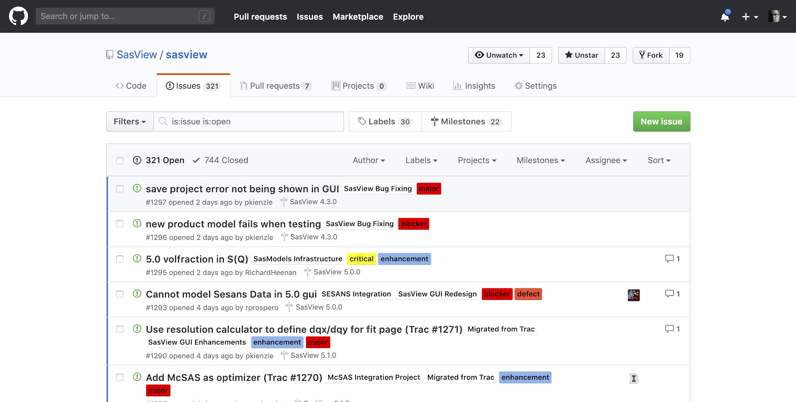
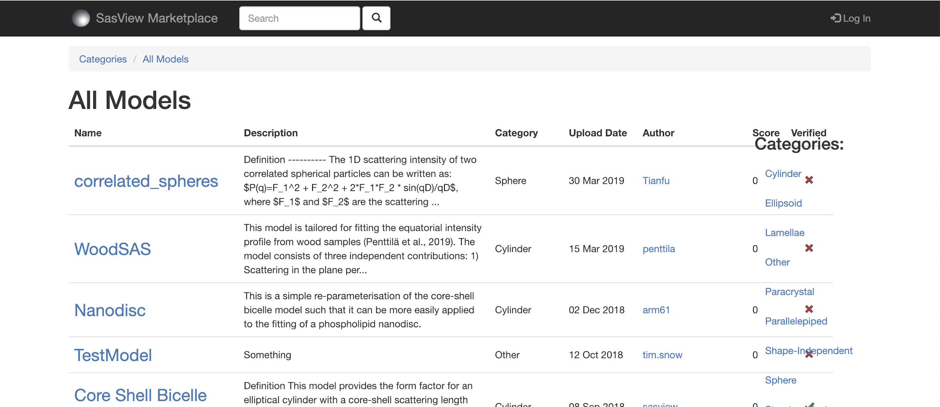



Open, Collaborative, Community Development
Code is open source and publicly hosted at Github
Released under BSD 3-clause license
(Zenodo) DOI for each release
Website
Documentation: in-program & online
Written Tutorials
Video Tutorials (YouTube)
scattering schools/workshop
university courses
Bootcamps & regional workshops
Twitter
help@sasview.org
users@sasview.org
Rolling 5 Year Roadmap
Code Hosting, Issue Tracking, Developer Wiki & CI on Public Github repos
Model Marketplace for Users to share their models
https://github.com/SasView
http://marketplace.sasview.org
https://www.sasview.org

Slide 14
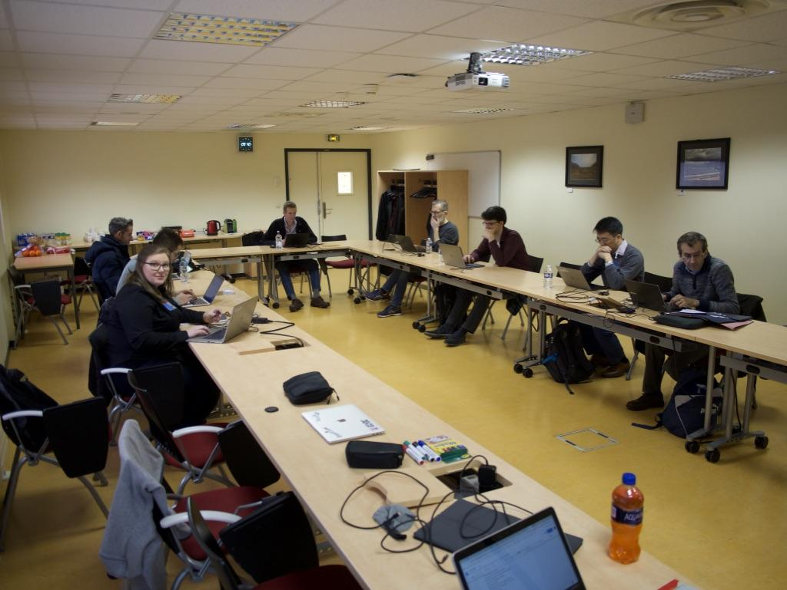
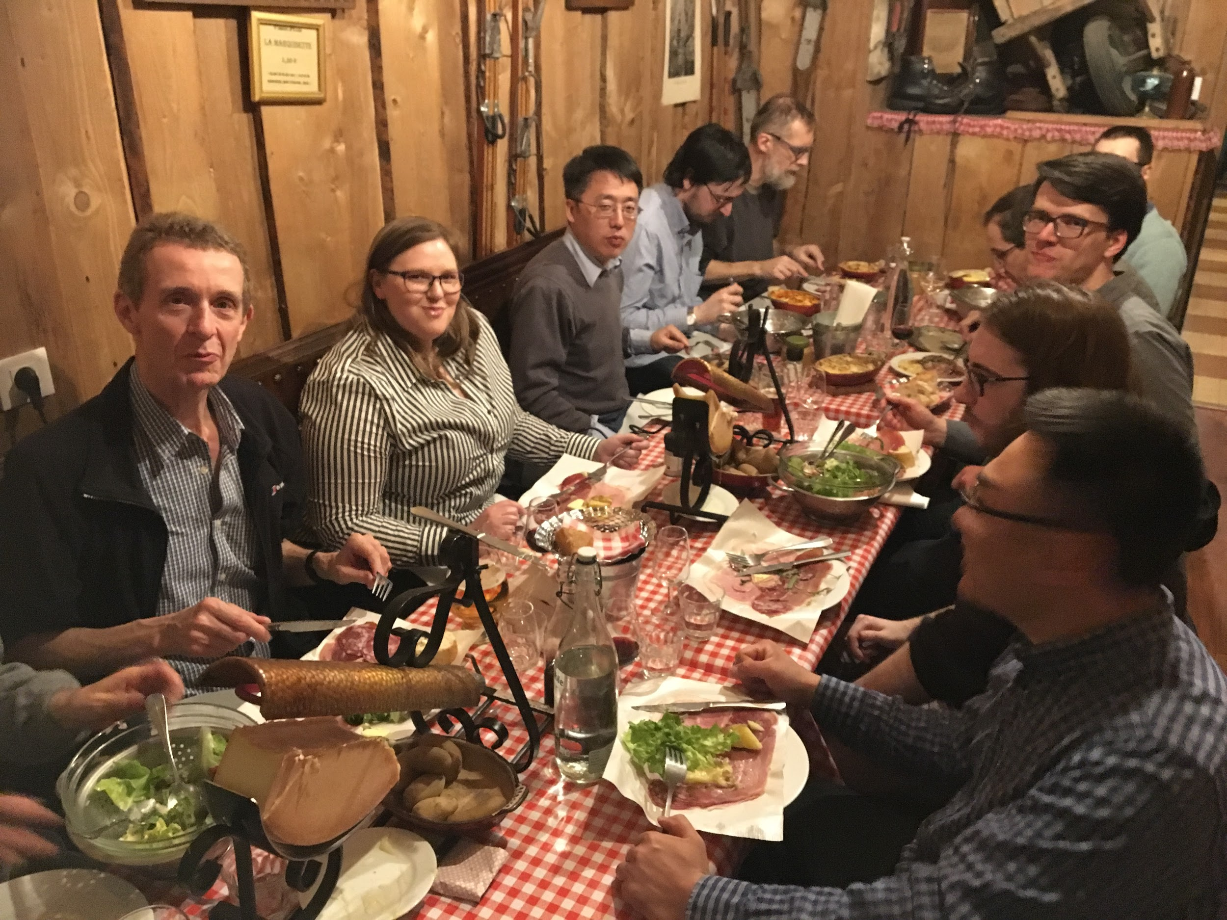
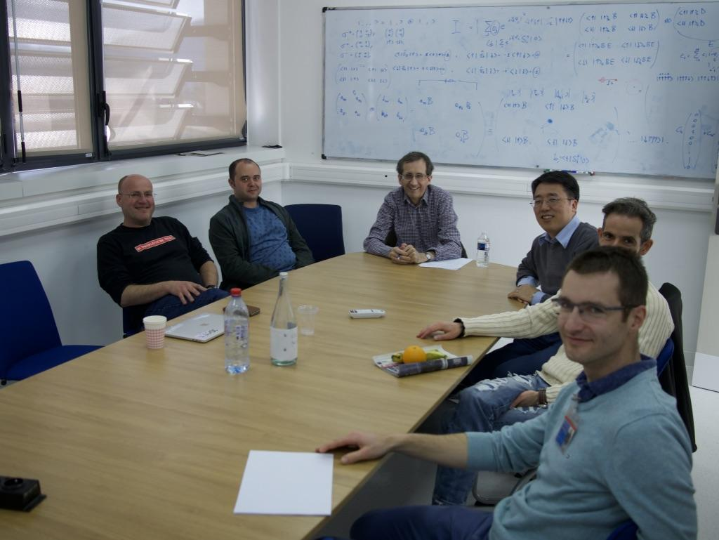
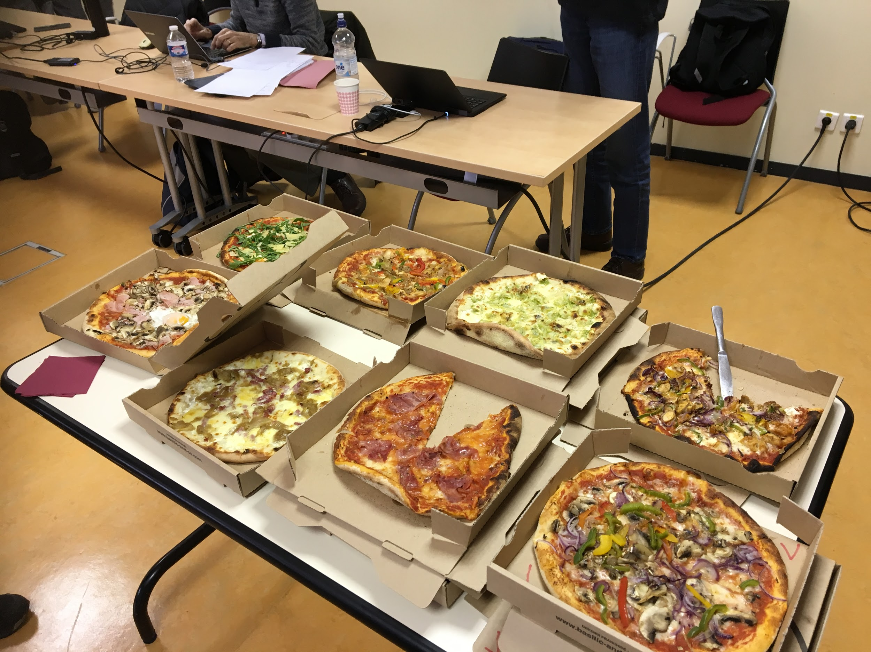
Open, Collaborative, Community Development
Twice monthly zoom calls
Regular ‘camps’ & ‘hackathons’
Developer's mailing list
SasView slack
Expertise sharing and helping
Small leadership team to facilitate
Collaboration also builds
Community
http://www.sasview.org
http://github.com/SasView

Slide 15
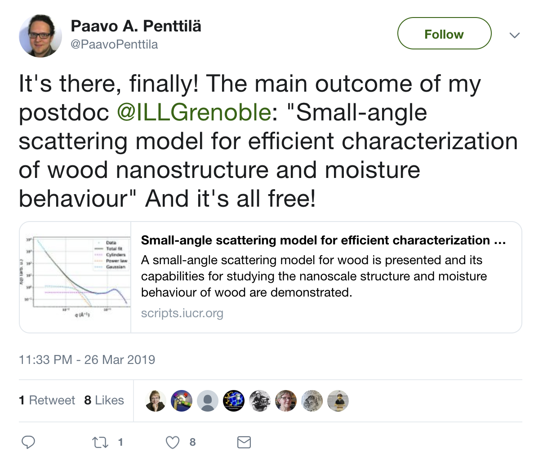
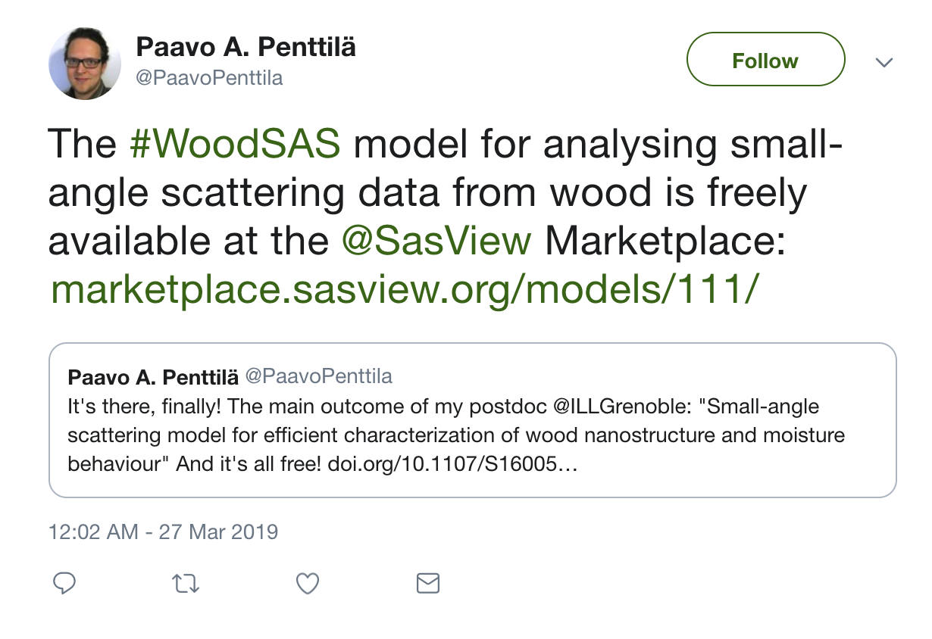
Open, Collaborative, Community Development
Ask not what the community is going to do for you,
ask what you can do for the community
P. Butler, March 2019
No MOU ... all are invited and welcome
Two Basic "Rules"
He who pays the piper …
Those who bring the resources (time and effort, or funds to buy time and effort) choose what to work on.
And ...
You cannot break existing experiences ...
New dependencies vs long term maintenance (sustainability)
Code quality vs long term sustainability
Changing/degrading the current user experience for the existing user base
http://www.sasview.org
http://github.com/SasView

Slide 16
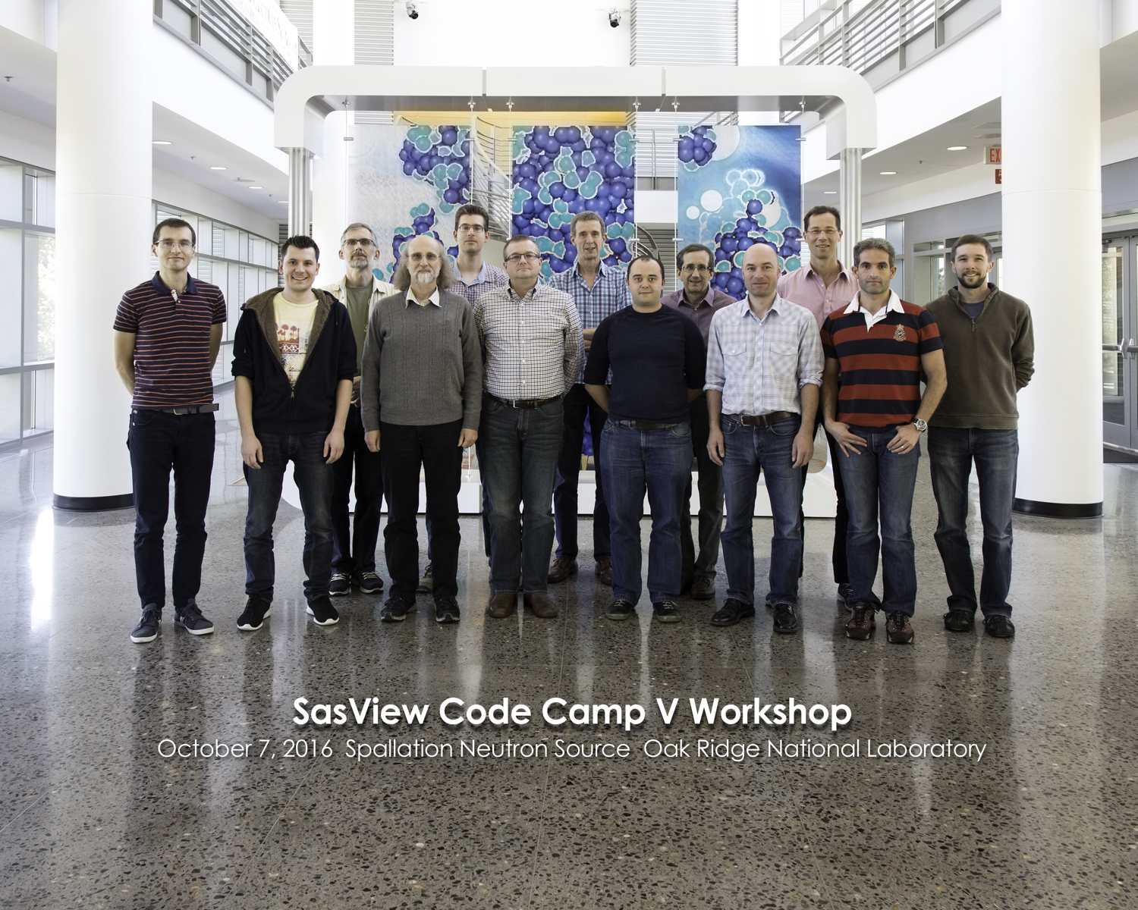
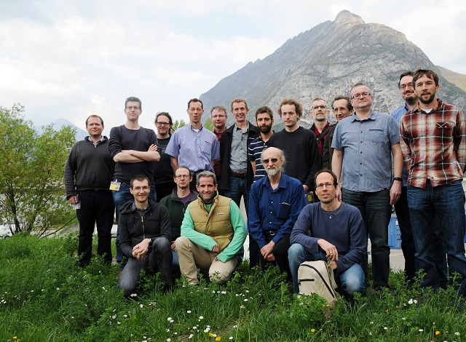
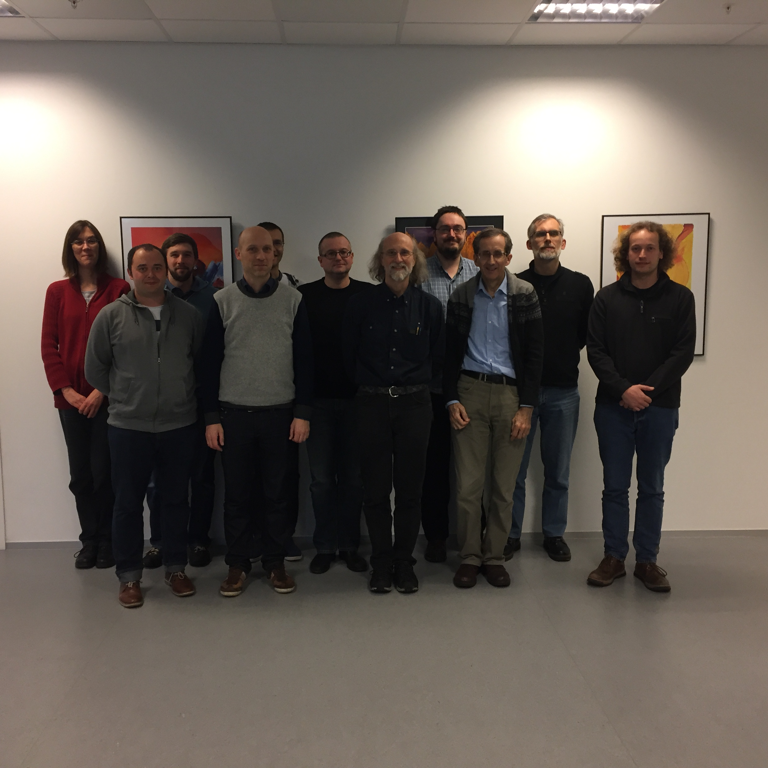
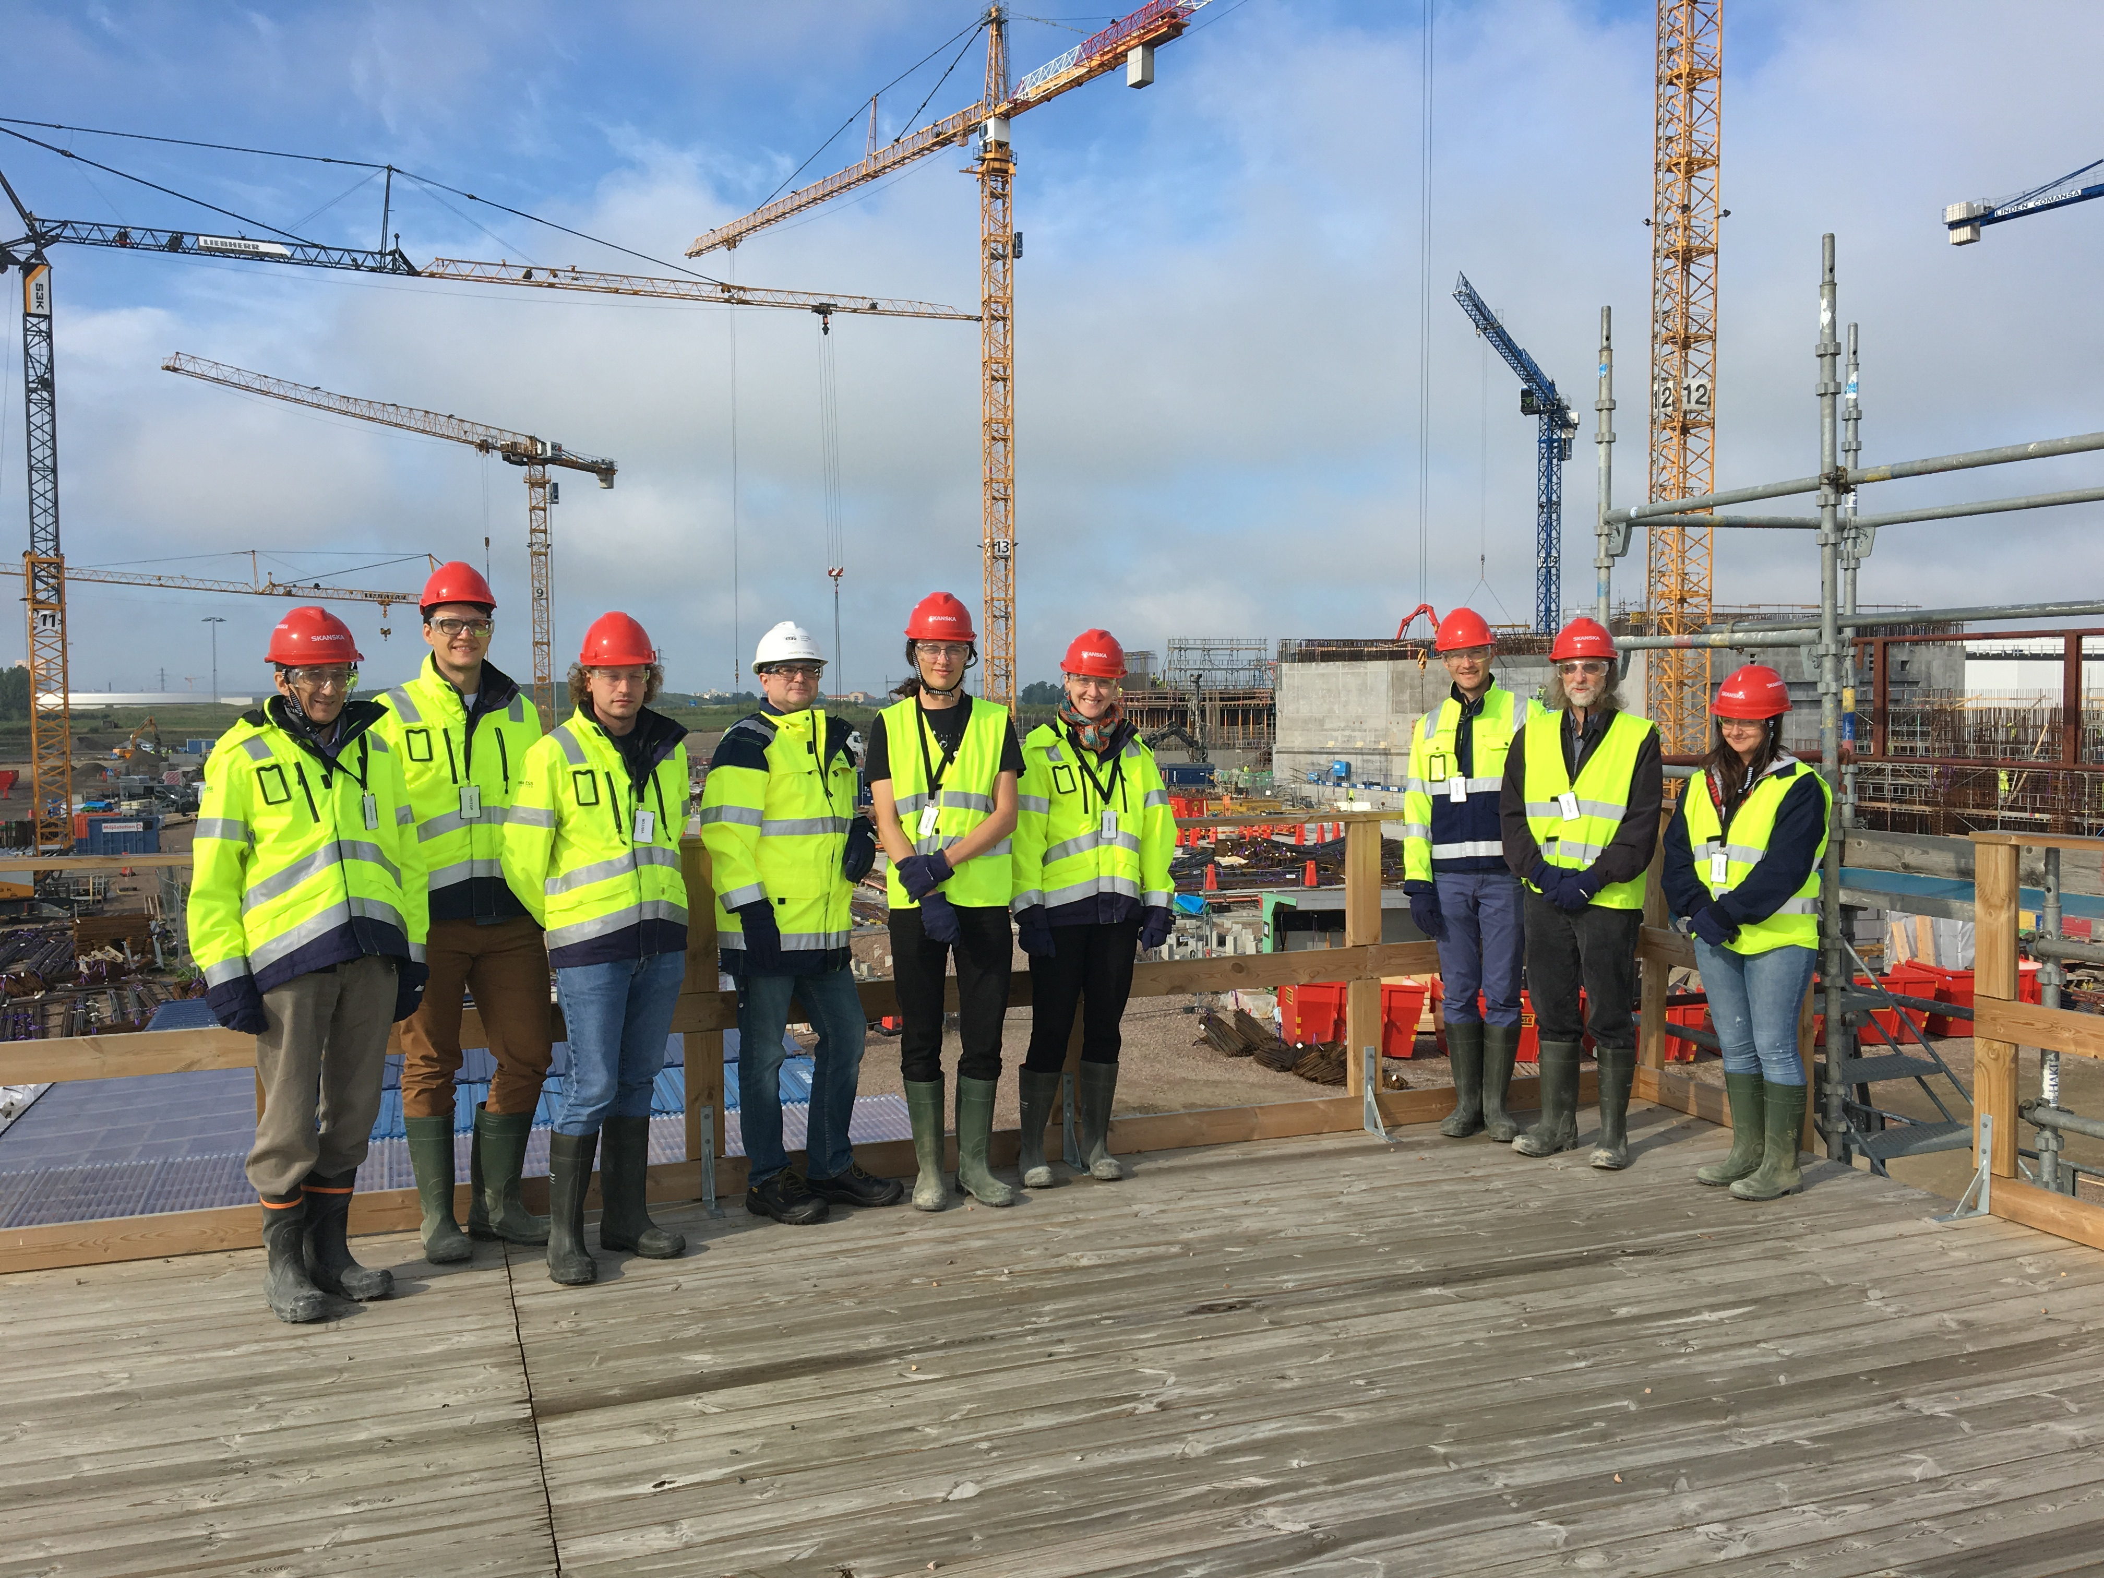
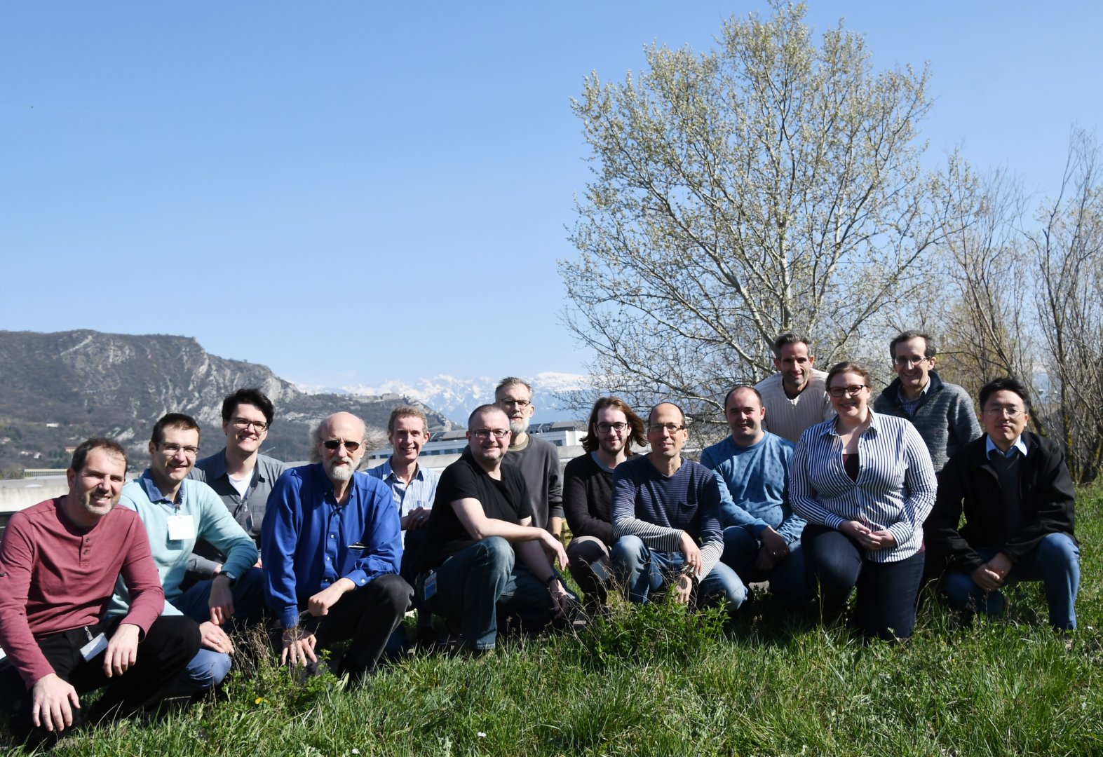
History and Status of SasView
2006; originates in NSF DANSE project
2013; transitions into a community project
2016; Sine2020 project funded
2022; Essentially a “volunteer army”
--------------------
~40 contributors from 9 organizations so far (~10-15 active at any one time)
1 to 2 releases/year (5.0.5 JUST RELEASED)
Documentation/tutorial projects ongoing
Usage? Seems to be "everywhere?"
Publications? > 100/year

Slide 17
SasView Model: Some Current Problems
The price of success:
The tragedy of the commons: somebody else will take care of the problem.
Hard to get non-coders to believe they can contribute equally – it is unfortunately in the name “code camp” … words matter → SasView camp?
Building community, especially during a pandemic is HARD WORK
Lack of funds for small things … but beware too much money?
Hard to keep up with increasing security issues with these resources so far.
Many people view the project as a well-funded group of professionals → barrier to contribution – e.g: Old website and no graphics = not serious; Nice graphic slick website = professional → way beyond my skills – how to navigate?
Large project with many moving pieces is a barrier to new volunteer coders
Heavily geared towards colloid science

Slide 18
The resource Problem Reframed – The Solution
The SasView approach
Facilities provide foundational support through participation of data and instrument scientists
Grants and other projects provide “bold new functionality”
Community, writ large, helps provide support and functionality
New ideas tested and developed as before by individuals or larger groups (the community)
Once validated and deemed ready for the larger community these groups provide resources (their labor) to integrate while active developer community helps with training on where things go and on parts of interest to them (collaborative)

Slide 19
So … What Can SasView Do Currently?

Slide 20
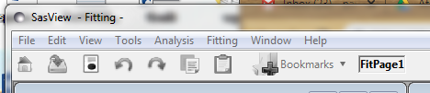


Perspectives on the data
Tools
Analysis
Data Operation
SLD calculator
Density/Volume calculator
Slit Size Calculator
Kiessig Thickness Calculator
Q Resolution Estimator
Generic Scattering calculator​
Orientation Viewer​
Python Shell/Editor​
Image Viewer​
File Converter​
Fitting
Invariant
Pr Inversion
Correlation Function

Slide 21
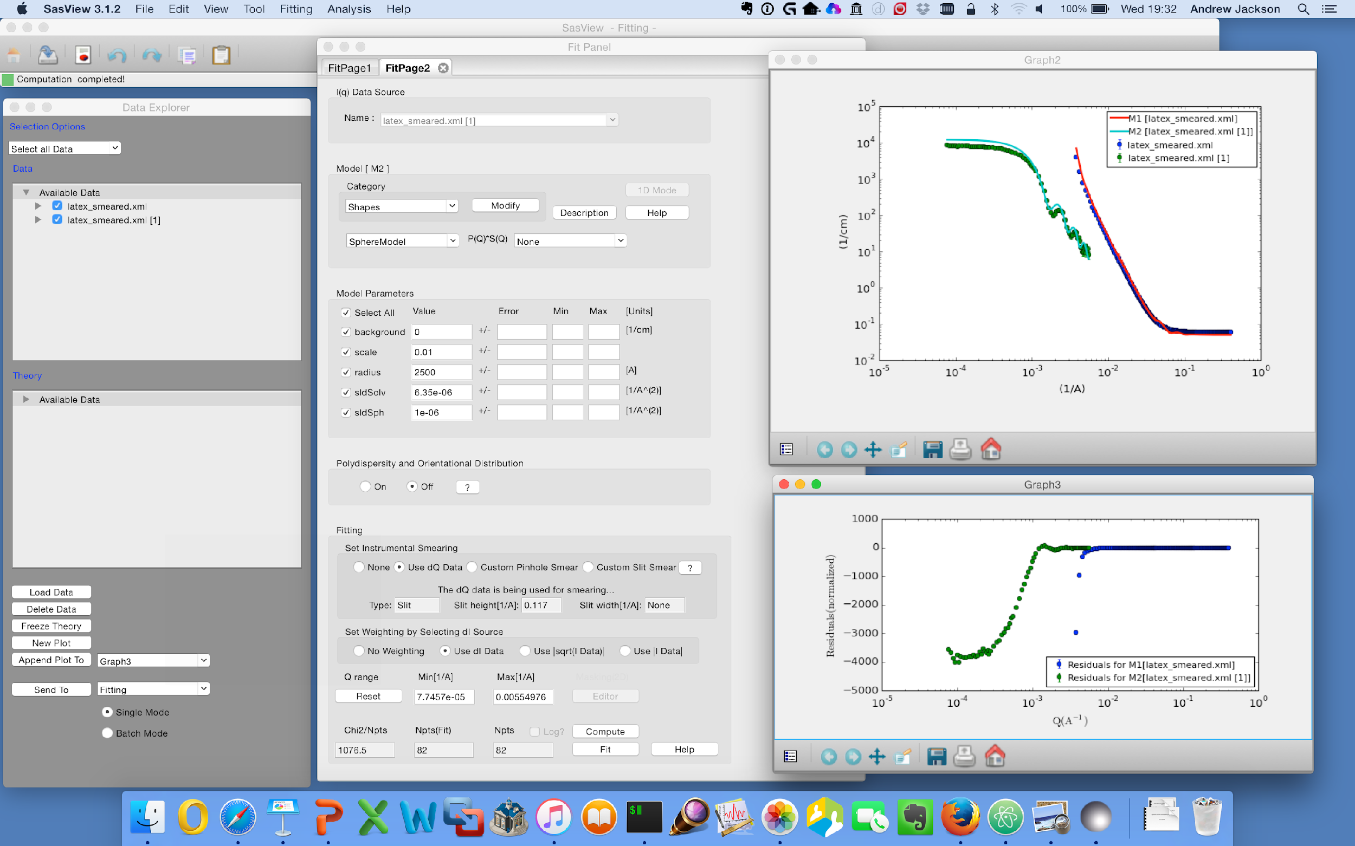
Fitting Perspective: 1D Analysis
Data management
Common data formats supported, including NXCansas & cansas1D
Wide choice of built-in models (> 70)
P(Q), S(Q) & P(Q)*S(Q)
Simultaneous fitting
Analysis Tool Choice
&
Plotting
Generic parameter polydispersity
Choice of distribution and distribution parameters
Resolution smearing (pinhole and slit)
Automatically from data or provide parameters

Slide 22
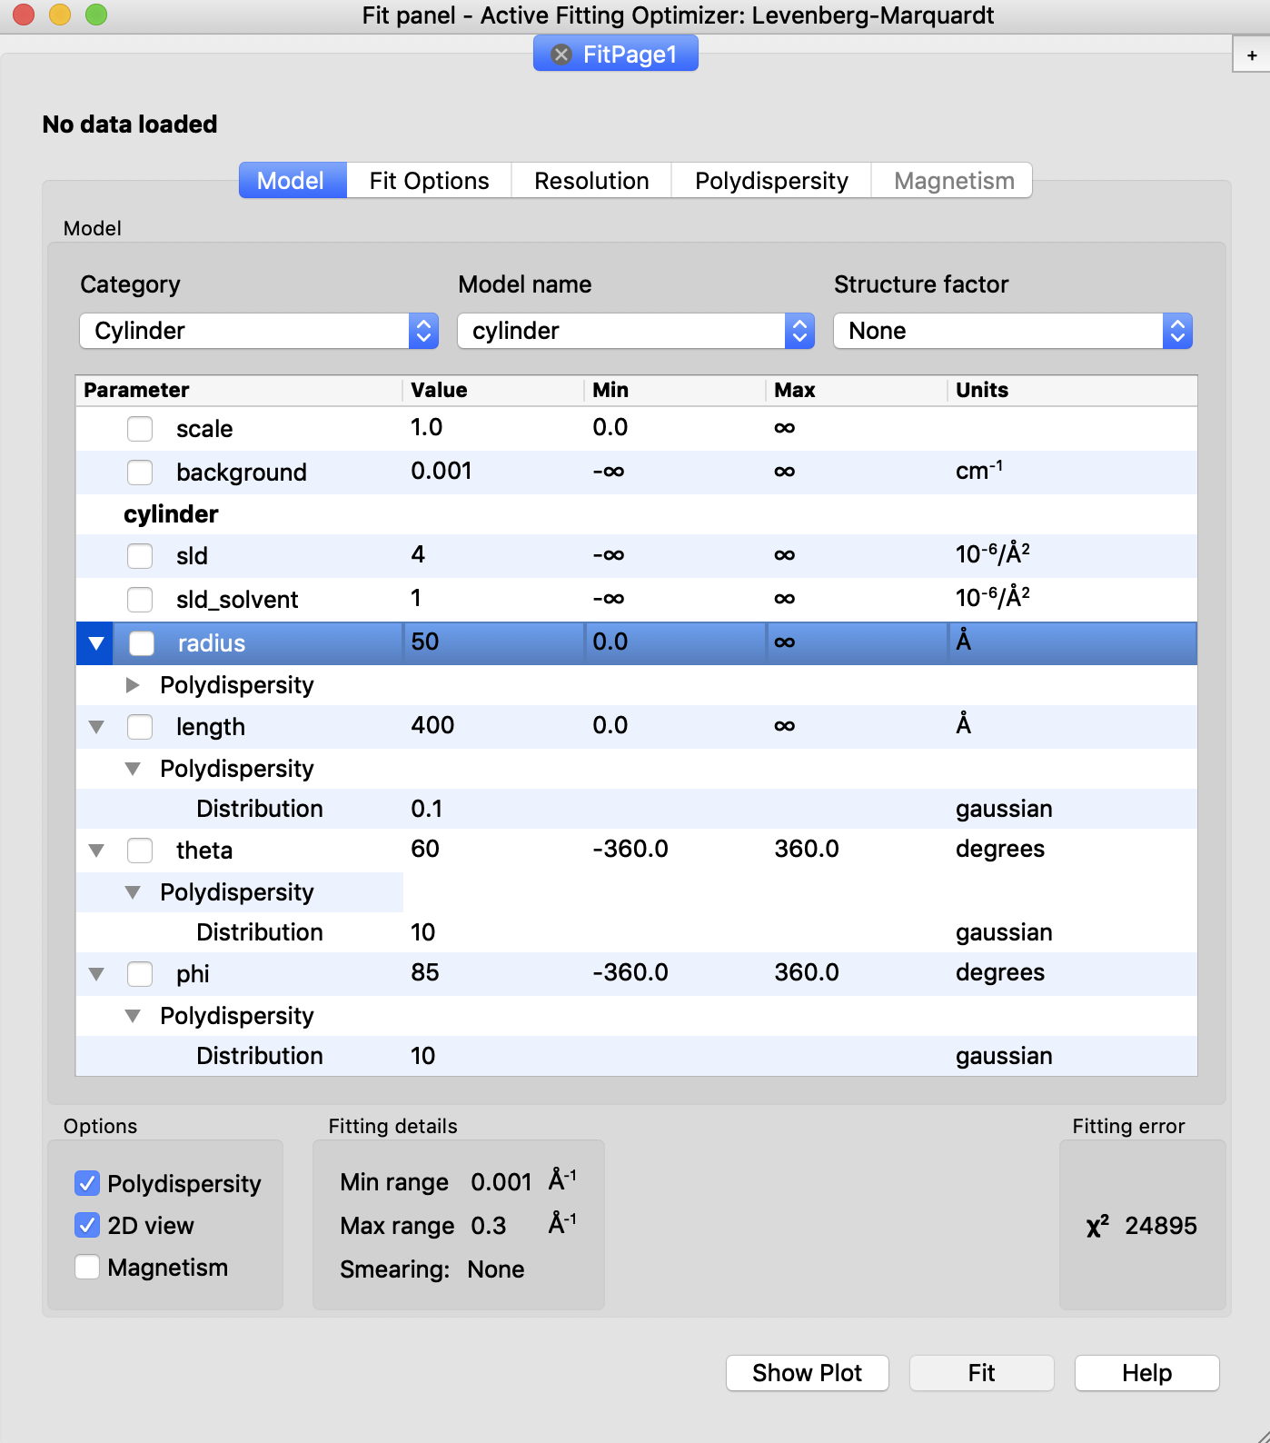
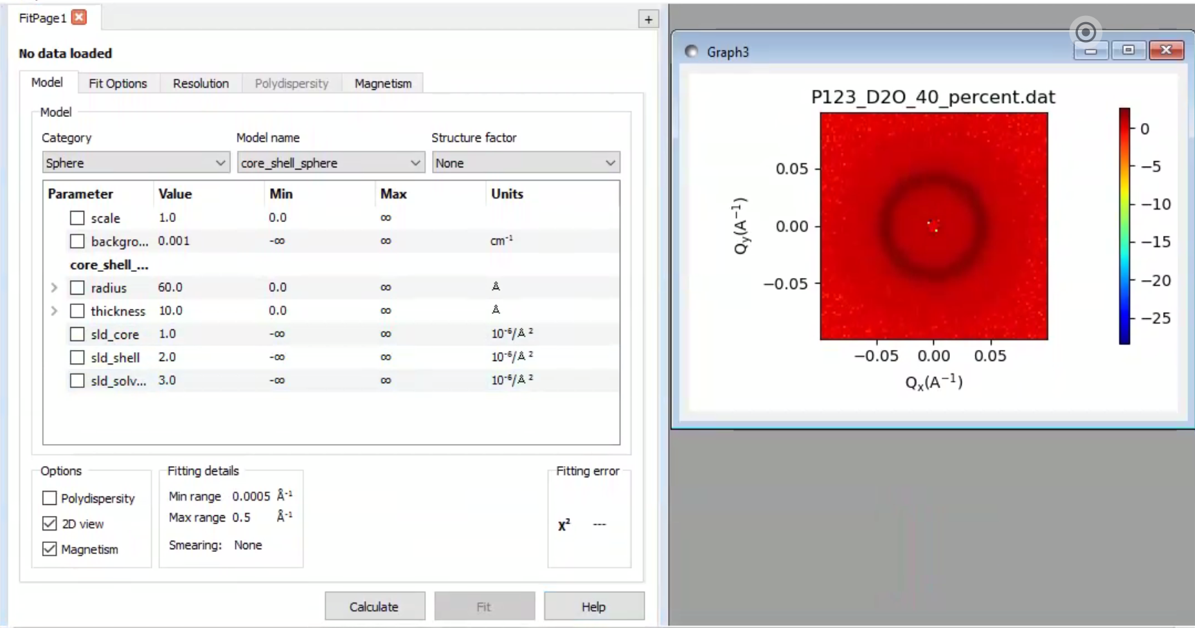
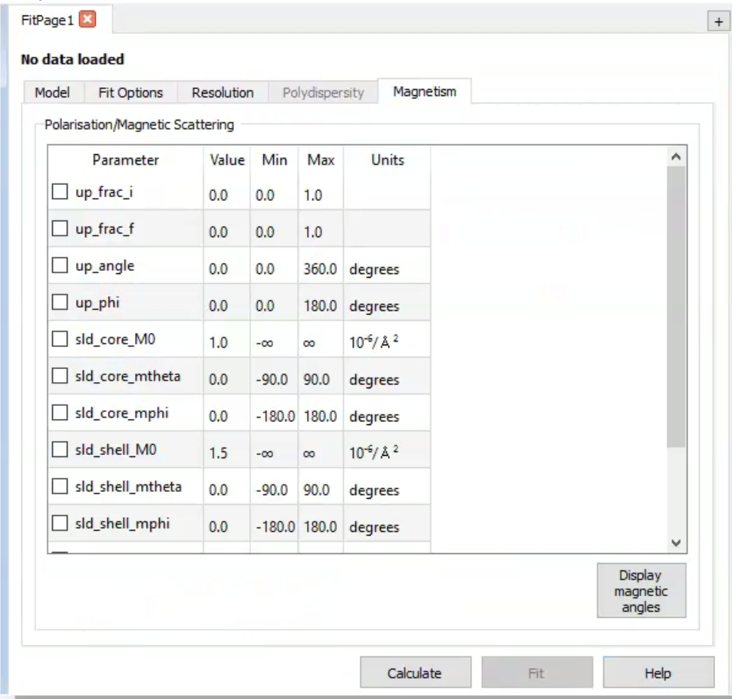
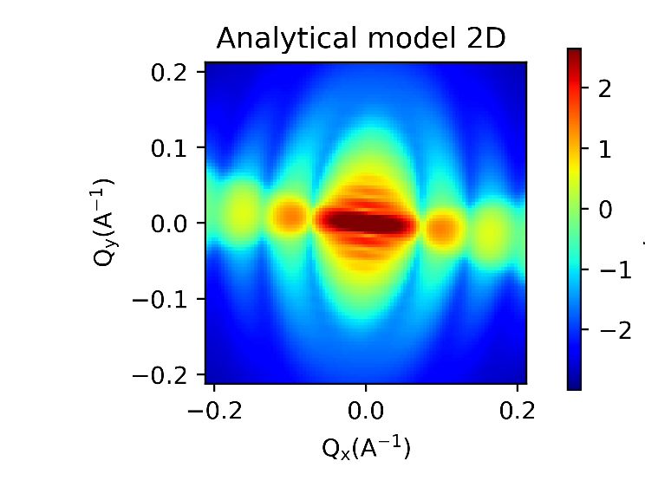
Fitting Perspective: 2D Analysis
Orientational polydispersity = “jitter”
Decouples the frame for the object’s orientation with respect to the beam and the “jitter” around the axis of the object.
Turning on GPU Option highly recommended for fitting

Slide 23
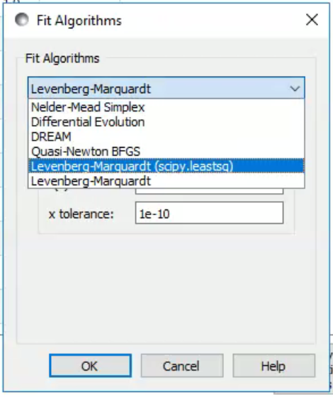
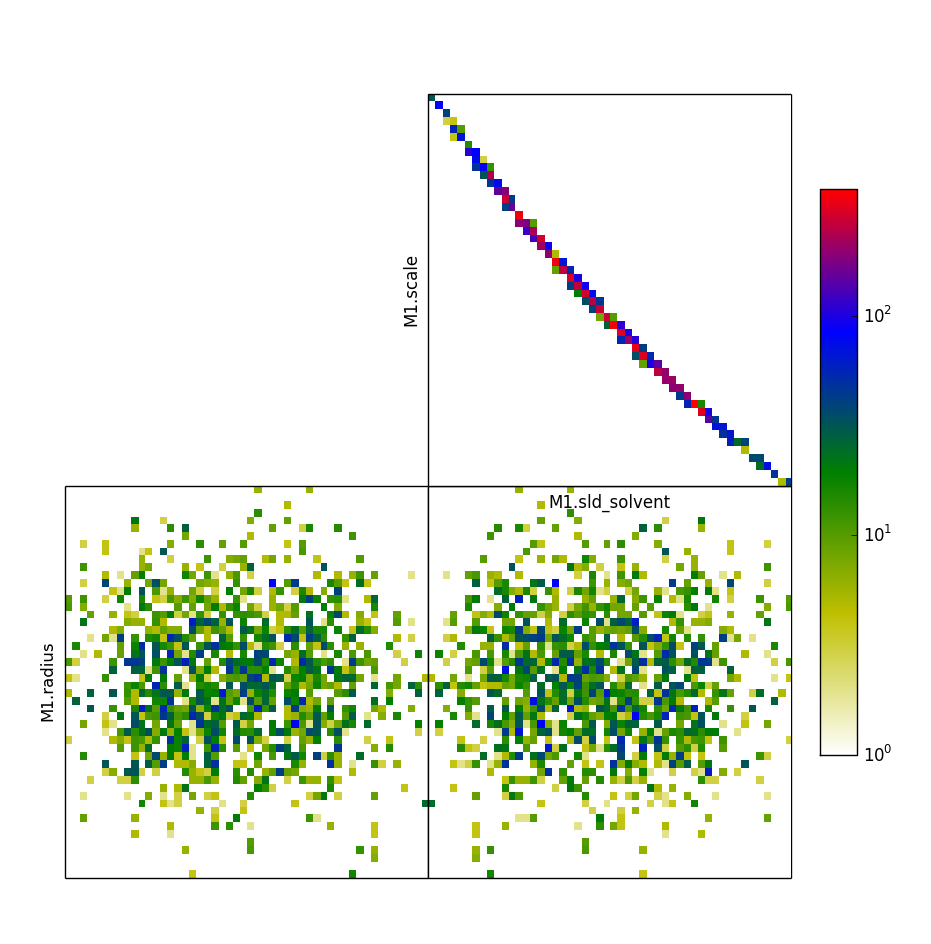
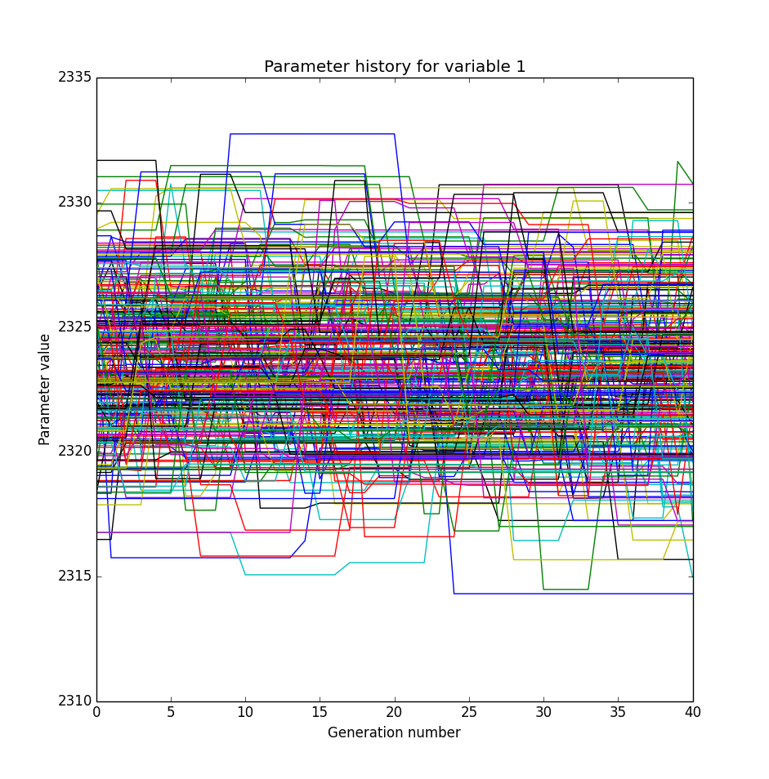
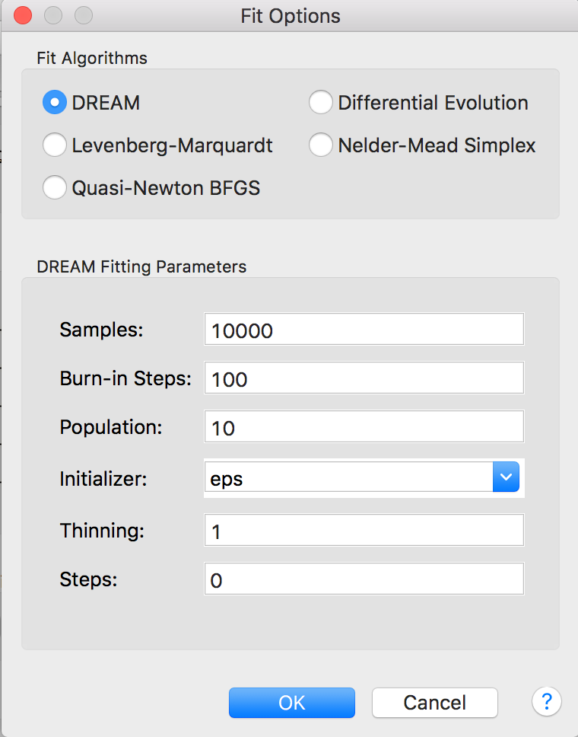
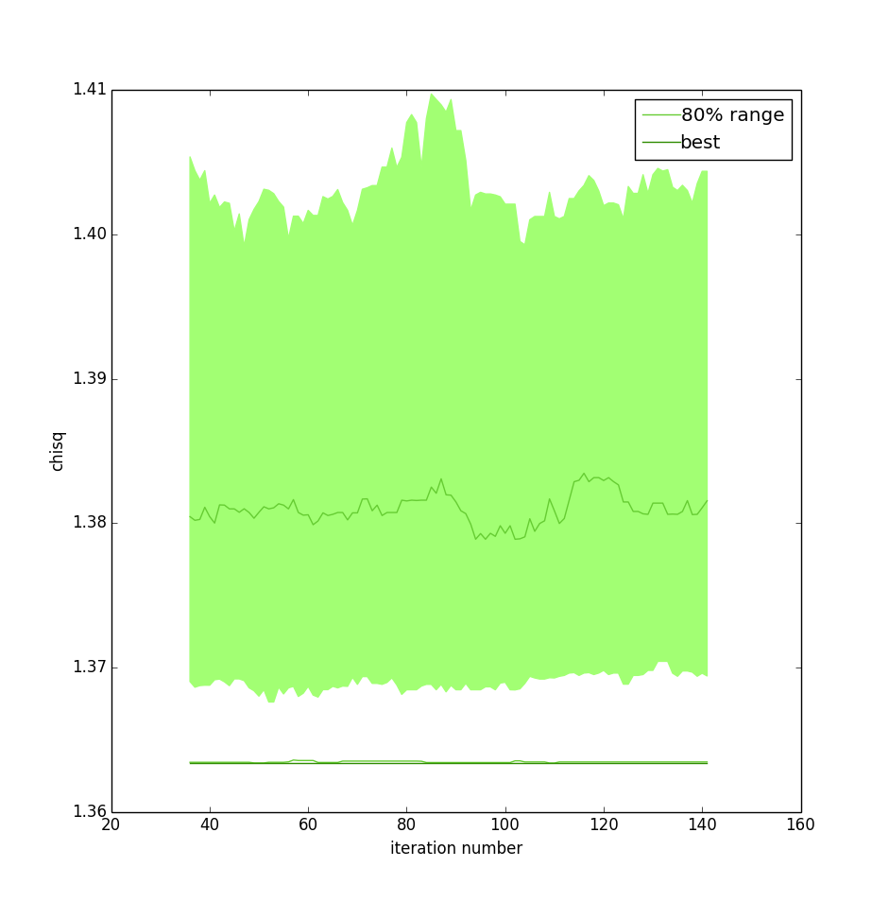
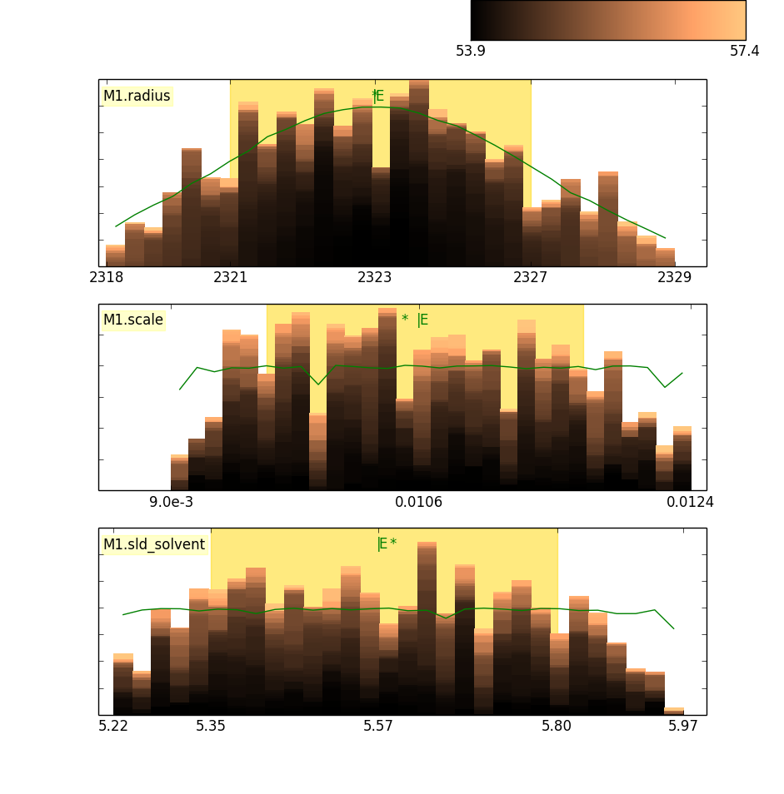
Choice of Fitting Algorithms
Uses bumps package from P. Kienzle
(also has DANSE origins)

Slide 24
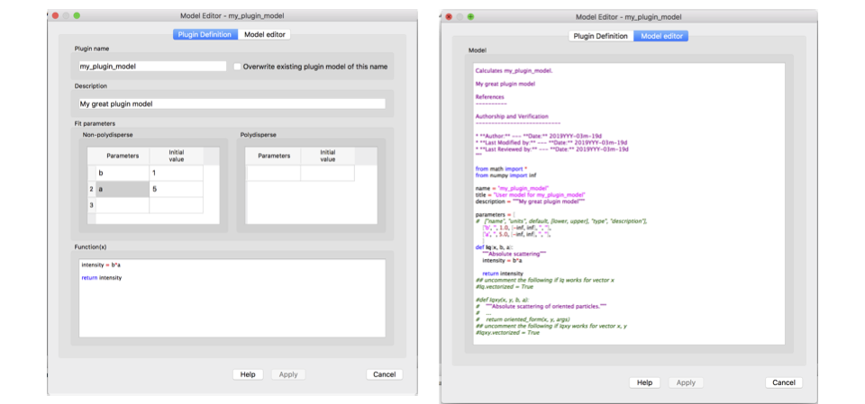



Plugin Model Editor
Model Documentation built in
Parameter definition
Model calculation
Tests etc

Slide 25
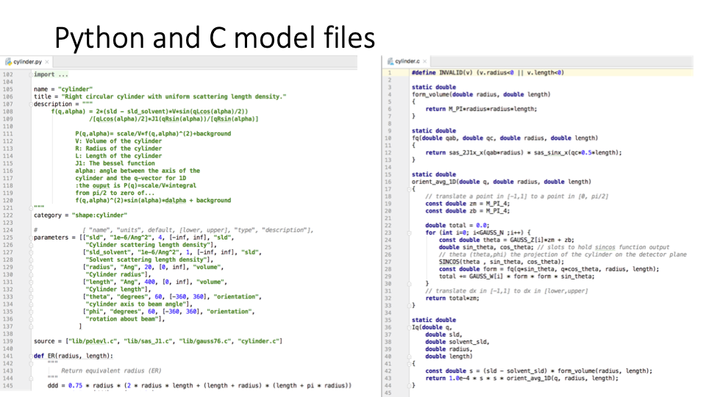

Plugin Model Editor: Python & C model files
Complex numbers not originally supported – a bit in C now

Slide 26
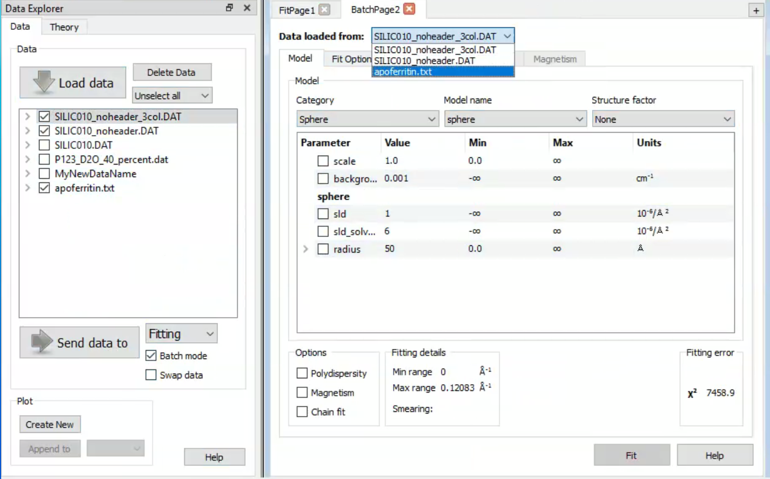
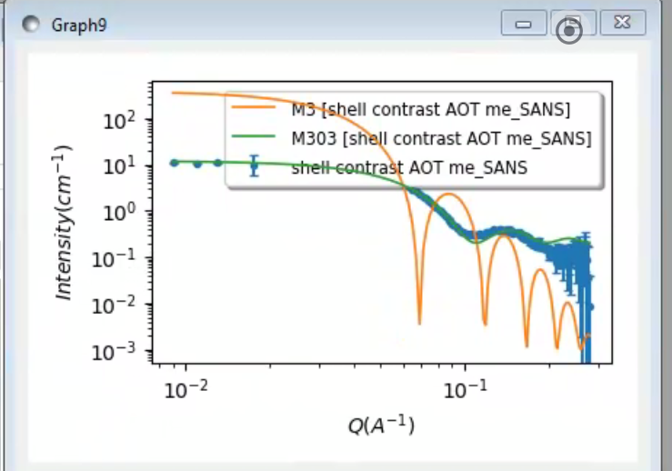


BATCH in Fitting

Slide 27

Constrained Fitting

Slide 28



Fitting Perspective: Invariant Calculation

Slide 29



Fitting Perspective: P(r) Inversion

Slide 30



Fitting Perspective: Correlation Function Analysis (new!)
CCP13 (Fiber Diffraction) legacy code (Fortran)
Implemented by an ISIS summer student)

Slide 31



SESANS Analysis
Automatic Hankel Transform of SANS models
(TU Delft & ISIS)

Slide 32

Data Operations and 1D stuff
PROBLEM: If using 2 data sets, ALL Q points must match
(not interpolation etc)

Slide 33



DATA and Slicers
2D data menu and slicer example
1D data
menu

Slide 34




Command Line and Jupyter Notebooks

Slide 35




Resources maintained and Education & Outreach
Website
Documentation
Written Tutorials
Video Tutorials (YouTube)
Taught courses
Scattering schools
University courses
E-learning
Twitter
Slack
Mailing Lists
Bootcamps & Regional Workshops
(Marketplace)

Slide 36



Resources maintained and Education & Outreach
Website
Documentation
Written Tutorials
Video Tutorials (YouTube)
Taught courses
Scattering schools
University courses
E-learning
Twitter
Slack
Mailing Lists
Bootcamps & Regional Workshops
(Marketplace)

Slide 37



Resources maintained and Education & Outreach
Website
Documentation
Written Tutorials
Video Tutorials (YouTube)
Taught courses
Scattering schools
University courses
E-learning
Twitter
Slack
Mailing Lists
Bootcamps & Regional Workshops
Marketplace
All the work of ISIS Sandwich Student Michael Oakley
Original put together by an SIS Summer Student Lewis O’Driscoll

Slide 38


The RoadMap
Living document
Guides and tracks developers' work
Helps find candidate projects for funding.
Discussed and updated at each Code Camp.
Hope to update after these discussions!!
Think about different Workflows and how to implement
https://github.com/SasView/documents

Slide 39


Come and Join the Fun!
Things people are saying about SansView/SasView
‘SansView is a very helpful tool, very complete and easy to use’ - Niki
‘I want to thank you for this amazing software. It’s UI and options make the interpretation of spectra easier and faster’ - Philippe
‘I really like the SasView software’ - Martin
‘I have found SasView very easy to use and the batch fit function is a wonderful time saving tool. I can finally stop making painful excel macros!’ - Andrew
‘Within 30 seconds…I am completely converted to SasView!’ - Mike
‘Thank you for creating and maintaining SasView. It is an incredibly helpful tool, and I use it regularly’ - Pasha

